Slide 1
Dimensionality Reduction: Principal Component Analysis

Slide 2



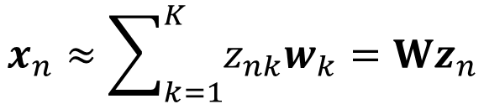
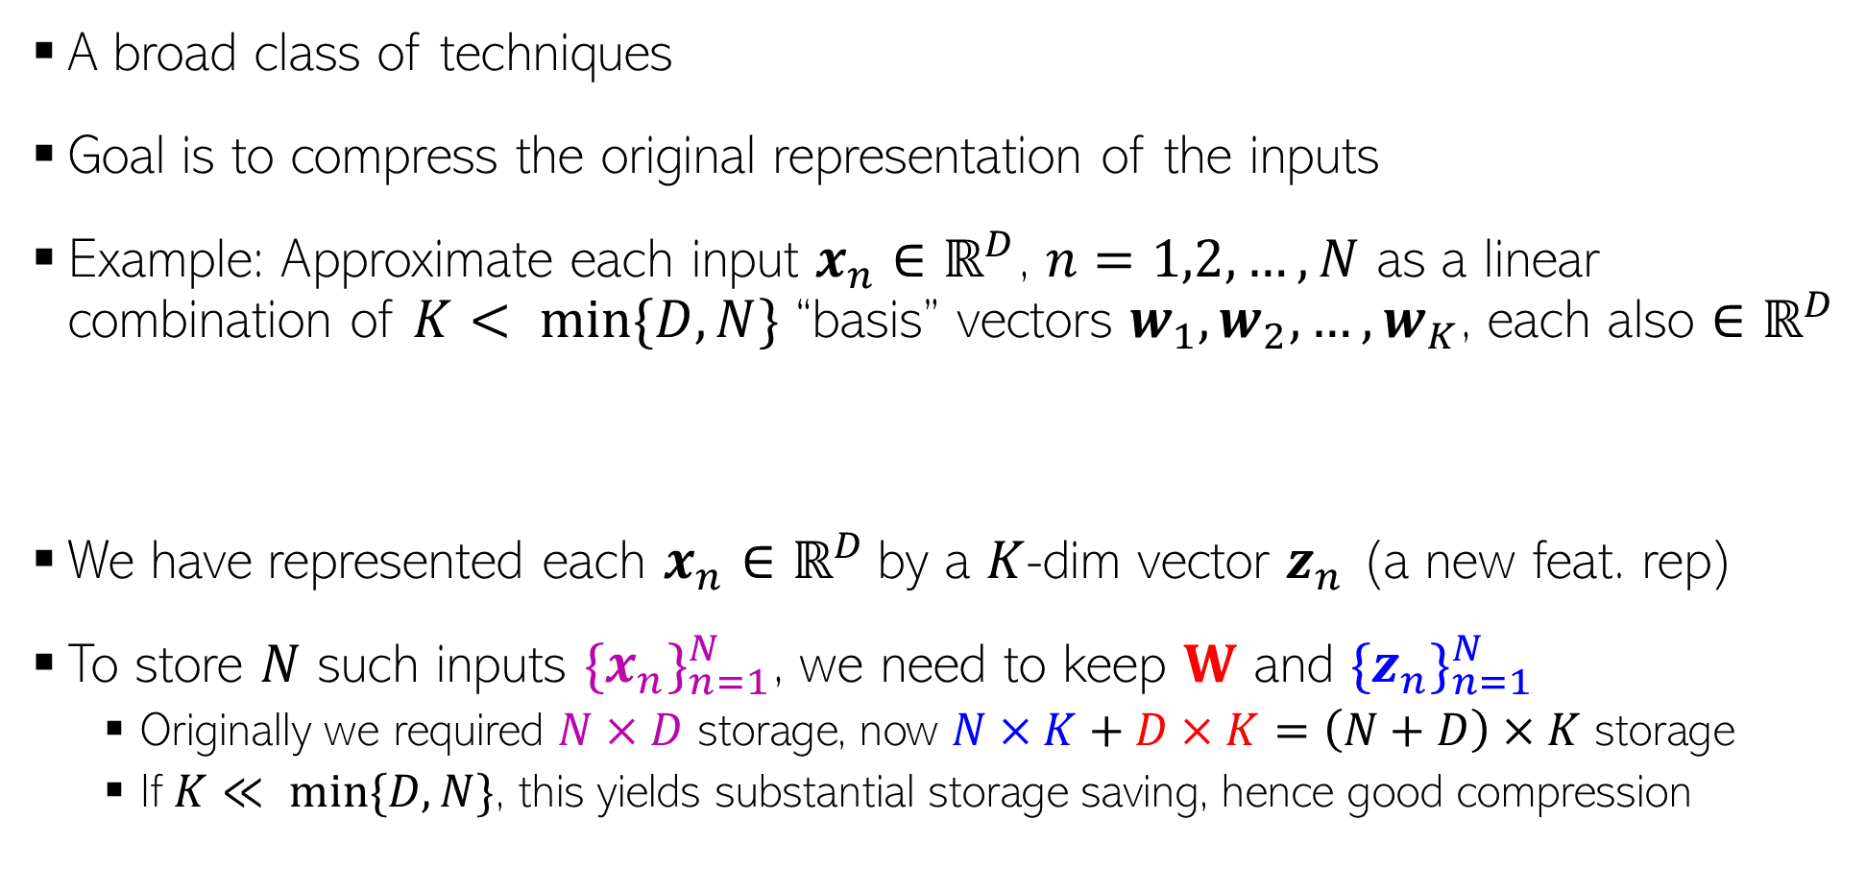

Dimensionality Reduction
Can think of W as a linear mapping that transforms low-dim $z_{n}$ to high-dim $x_{n}$
A broad class of techniques
Goal is to compress the original representation of the inputs
Example: Approximate each input $x_{n}∈ℝ^{D}$, $n=1,2,…,N$ as a linear combination of $K< min\{D,N\}$ “basis” vectors $w_{1},w_{2},…, w_{K}$, each also $∈ℝ^{D}$
We have represented each $x_{n}∈ℝ^{D}$by a $K$-dim vector $z_{n}$ (a new feat. rep)
To store $N$ such inputs ${\{x_{n}\}}_{n=1}^{N}$, we need to keep $W$ and ${\{z_{n}\}}_{n=1}^{N}$
Originally we required $N×D$ storage, now $N×K+D×K=\left(N+D\right)×K$ storage
If $K≪ min⁡\{D,N\}$, this yields substantial storage saving, hence good compression
$$x_{n}≈\sum_{k=1}^{K}{z_{nk}w_{k}}=Wz_{n}$$
$W=\left[w_{1},w_{2},…, w_{K}\right]$ is $D×K$
Note: These “basis” vectors need not necessarily be linearly independent. But for some dim. red. techniques, e.g., classic principal component analysis (PCA), they are
$z_{n}=\left[z_{n1},z_{n2},…, z_{nK}\right]$ is $K×1$

Slide 3
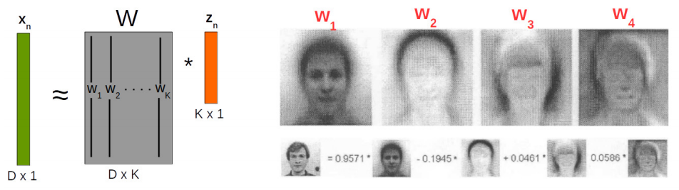


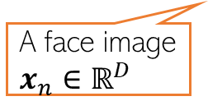







Dimensionality Reduction
Each “basis” image is like a “template” that captures the common properties of face images in the dataset
Dim-red for face images
In this example, $z_{n}∈ℝ^{K} (K=4)$ is a low-dim feature rep. for $x_{n}∈ℝ^{D}$
Essentially, each face image in the dataset now represented by just 4 real numbers ☺
Different dim-red algos differ in terms of how the basis vectors are defined/learned
.. And in general, how the function $f$ in the mapping $x_{n}= f(z_{n})$is defined
K=4 “basis” face images
+
A face image $x_{n}∈ℝ^{D}$
$$z_{n1}$$
$$z_{n2}$$
$$z_{n3}$$
$$z_{n4}$$
$$w_{4}$$
$$w_{1}$$
$$w_{2}$$
$$w_{3}$$
Like 4 new features

Slide 4
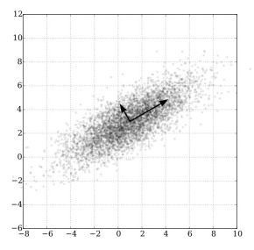

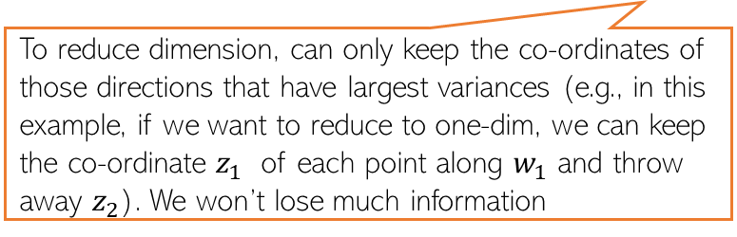



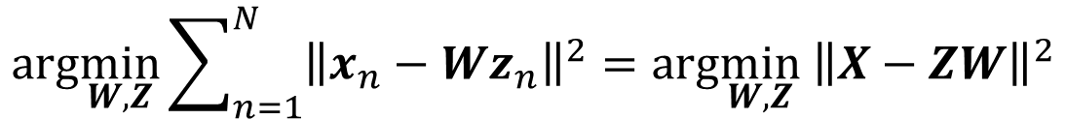


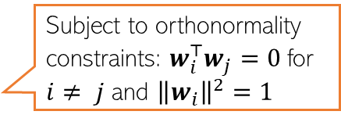
Principal Component Analysis (PCA)
A classic linear dim. reduction method (Pearson, 1901; Hotelling, 1930)
Can be seen as
Learning directions (co-ordinate axes) that capture maximum variance in data
Learning projection directions that result in smallest reconstruction error
PCA also assumes that the projection directions are orthonormal
$$e_{2}$$
PCA is essentially doing a change of axes in which we are representing the data
$e_{1},e_{2}:$ Standard co-ordinate axis ($x=[x_{1},x_{2}]$)
$$w_{1}$$
$$w_{2}$$
$w_{1},w_{2}:$ New co-ordinate axis ($z=[z_{1},z_{2}]$)
Small variance
Each input will still have 2 co-ordinates, in the new co-ordinate system, equal to the distances measured from the new origin
To reduce dimension, can only keep the co-ordinates of those directions that have largest variances (e.g., in this example, if we want to reduce to one-dim, we can keep the co-ordinate $z_{1}$ of each point along $w_{1}$ and throw away $z_{2}$). We won’t lose much information
Large variance
$$e_{1}$$
Subject to orthonormality constraints: $w_{i}^{⊤}w_{j}=0$for $i≠ j$ and ${\left\|w_{i}\right\|}^{2}=1$
$$arg\min_{W,Z}\sum_{n=1}^{N}{{\left\|x_{n}−Wz_{n}\right\|}^{2}=arg\min_{W,Z}{ \left\|X−ZW\right\|}^{2}}$$

Slide 5



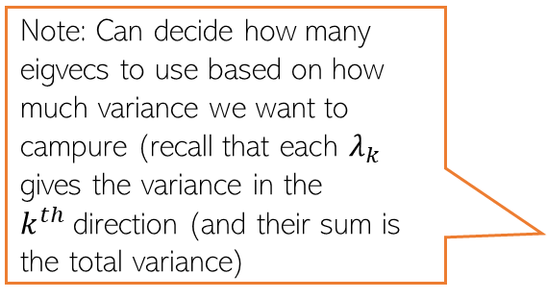
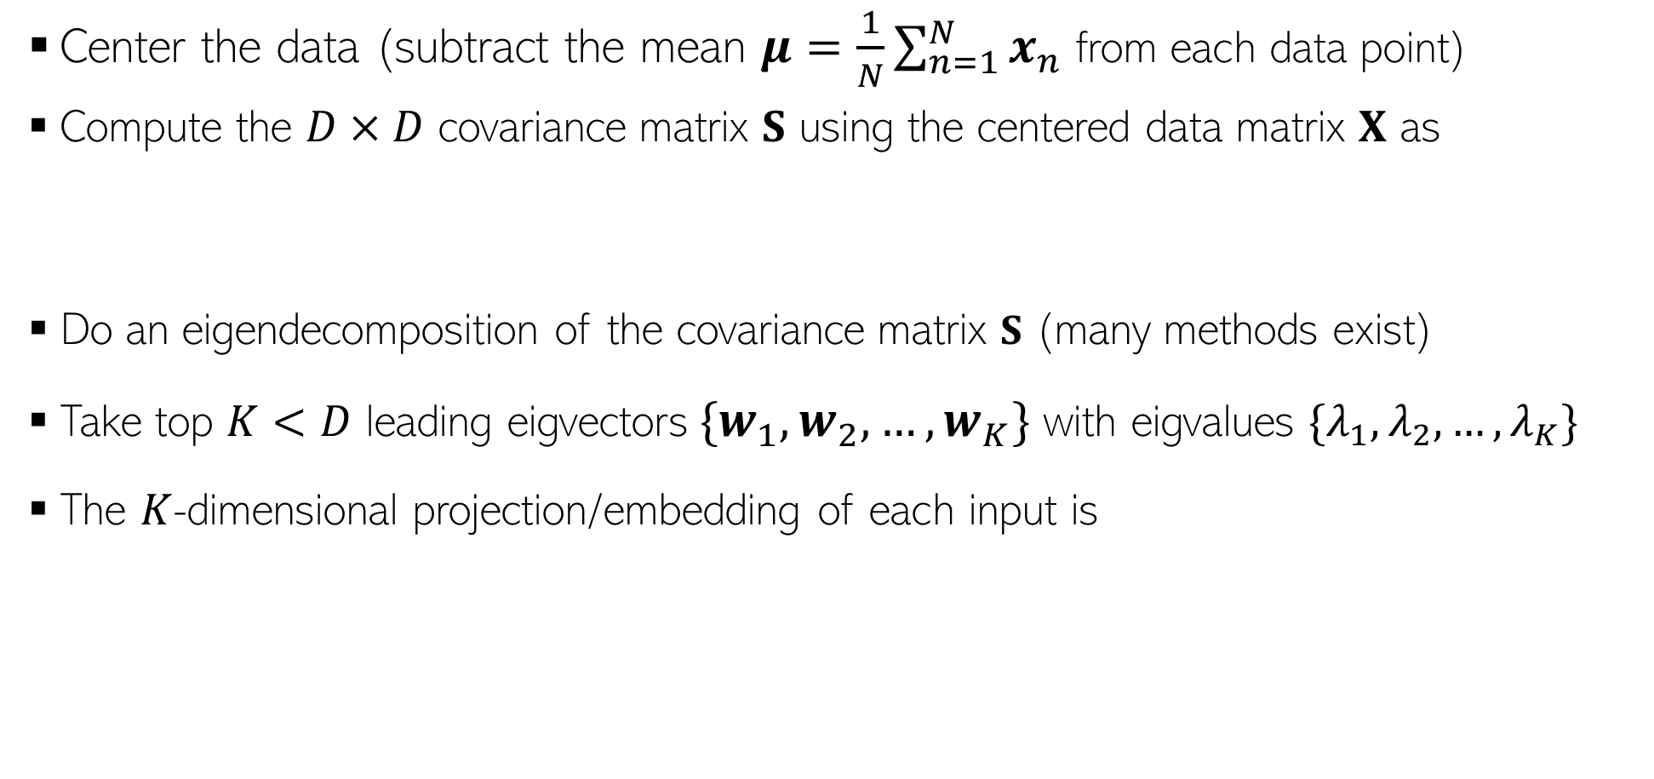

Principal Component Analysis
Center the data (subtract the mean $μ=\frac{1}{N}\sum_{n=1}^{N}{x_{n}}$ from each data point)
Compute the $D×D$ covariance matrix $S$ using the centered data matrix $X$ as
Do an eigendecomposition of the covariance matrix $S$ (many methods exist)
Take top $K<D$ leading eigvectors${\{w}_{1},w_{2},…, w_{K}\}$ with eigvalues $\{λ_{1},λ_{2},…, λ_{K}\}$
The $K$-dimensional projection/embedding of each input is
$$S= \frac{1}{N}X^{⊤}X$$
(Assuming $X$ is arranged as $N×D$)
Note: Can decide how many eigvecs to use based on how much variance we want to campure (recall that each $λ_{k}$ gives the variance in the $k^{th}$direction (and their sum is the total variance)
$$z_{n}≈ W_{K}^{⊤}x_{n}$$
$W_{K}=\left[w_{1},w_{2},…, w_{K}\right]$ is the “projection matrix” of size $D×K$

